Slide 1
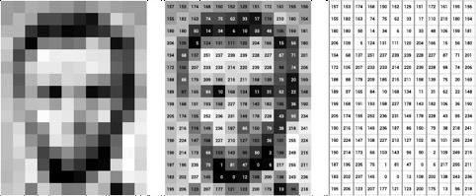
DIGITAL IMAGE
A Digital image is a 2D matrix made up of small box units called pixel.
The numerical value for each pixel depicts its intensity.
The intensity can range between 0-255.
pixel
Fig 1. Digital Image (Black and white) Representation
*https://datascience.aero/computer-vision-seeing-interpreting-images/

Slide 2
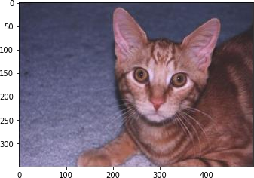
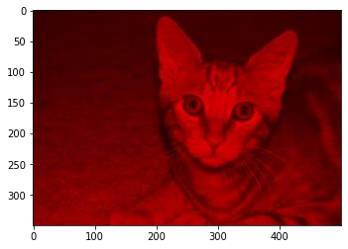
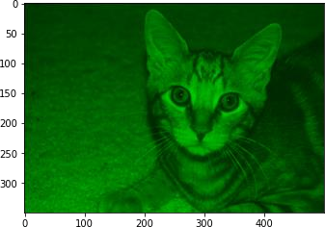
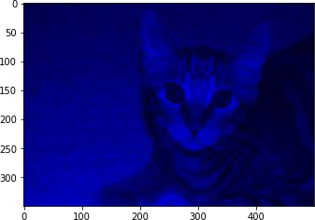
COLOR IMAGES
Colored image consist of three channels: Red, Green and Blue.
Each channel intensity value may range between 0 and 255.
Hence, each pixel is represented by three values. Different intensity values from these channels defines the object’s color.
RGB image
R-channel G-channel
Fig. 2. Colored image and its R,G and B channels.
B-channel

Slide 3
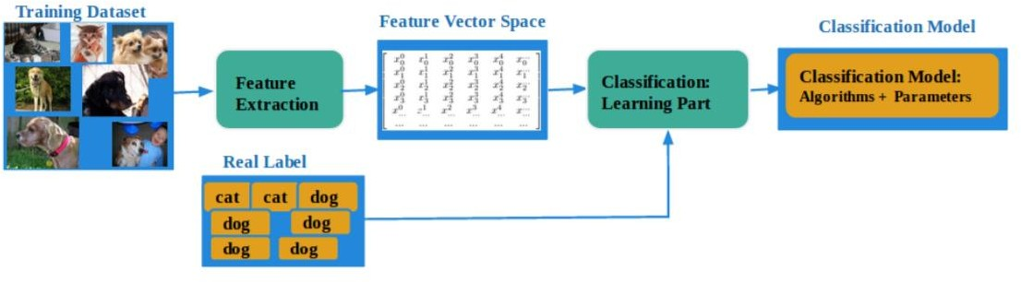
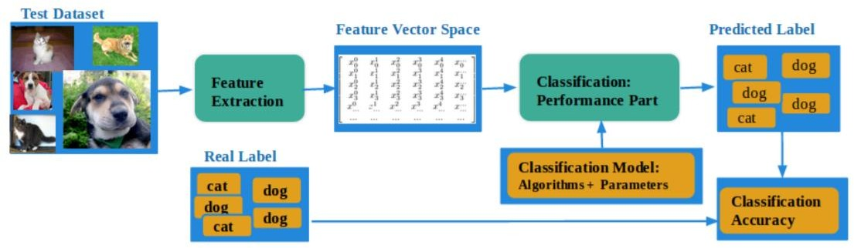
IMAGE CLASSIFICATION FRAMEWORK
Fig 4. Image classification Framework (a) Training framework (b) testing framework.

Slide 4
Challenges
Limited data availability due to data cleaning.
Limited labelled training samples (Supervised Learning).
Limited Data diversifications.
Difficulty in creating Generalised deep learning models.

Slide 5
Data Augmentation
It is a technique to create a diverse training dataset for robust models.
It deals with applying image transformations such as image restoration, flipping, resizing etc.
It should be applied to training data only.

Slide 6
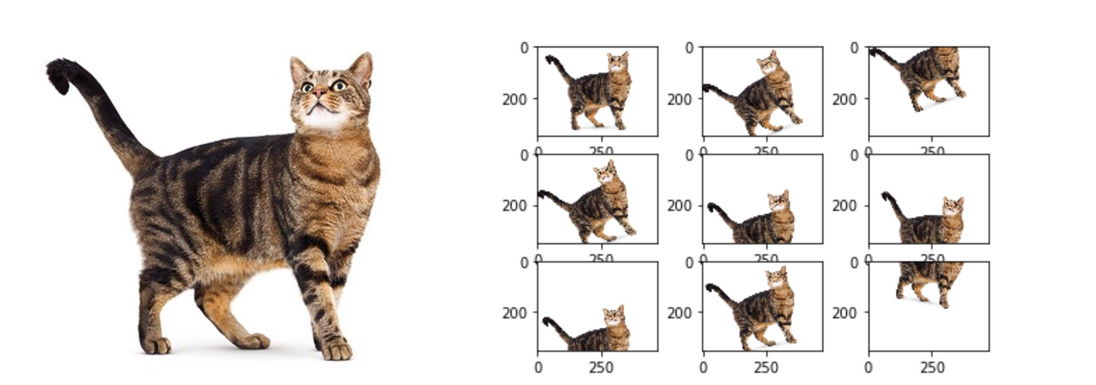
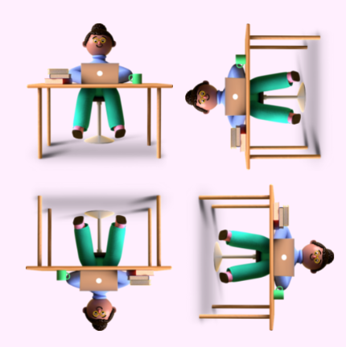
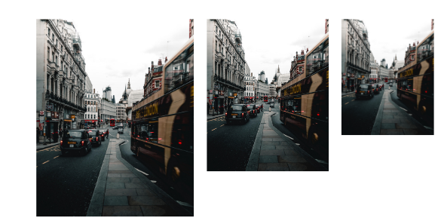
ImAGE AUGMENTATION
a. Image rotation and width-height shift
c. Horizontal and vertical flip
b. Image resizing

Slide 7
Generative Modeling

Slide 8
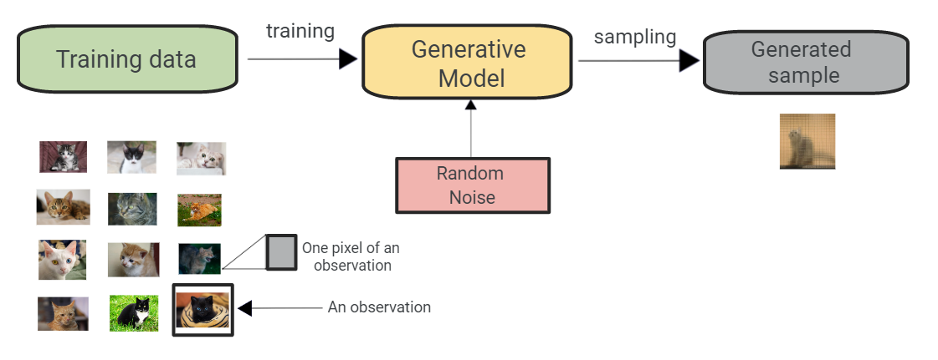
Generative Modeling

Slide 9
Key Terms
Sample space:A sample space is a set of elements with a defined property. It can be denoted by X.
e.g.: Number of samples in the training dataset of dogs and cats
Probability Distribution: The probabilities of the values taken by random variable.
Domain: It comprises of a sample space X, and the probability distribution Px. It can be defined as D={X, Px}.

Slide 10
Generative Modeling
Given a training sample T defined by a domain as D(X,Px). The objective of generative modelling is to create a function G, that is capable to capture Px.
The result of Generative modelling is G encoding a probability distribution Pmodel, that mimics the Px, statistically.
Based on Pmodel, G will generate samples.

Slide 11
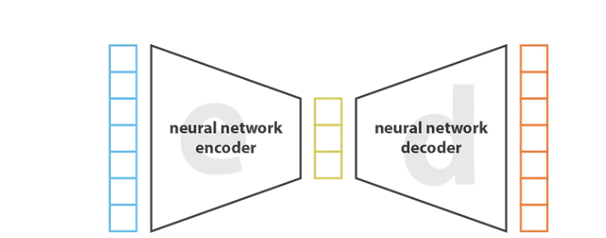
Generative Modeling

Slide 12
AutoEncoders
AutoEncoder: An autoencoder is a type of neural network architecture designed to efficiently compress (encode) input data down to its essential features, then reconstruct (decode) the original input from this compressed representation.

Slide 13
AutoEncoders
AutoEncoder: An autoencoder is a type of neural network architecture designed to efficiently compress (encode) input data down to its essential features, then reconstruct (decode) the original input from this compressed representation.
Variational Autoencoder: comes from Autoencoder by learning the distribution of the code, rather than the code.

Slide 14
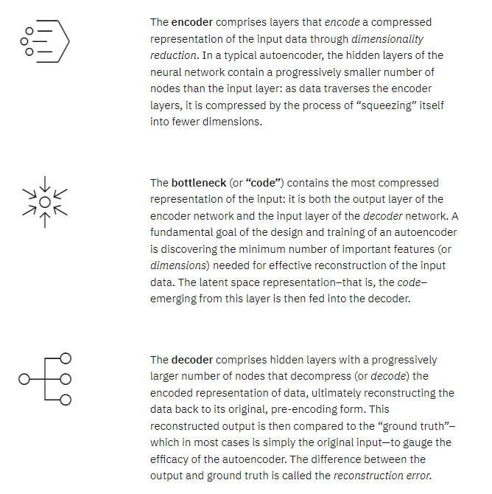

Slide 15
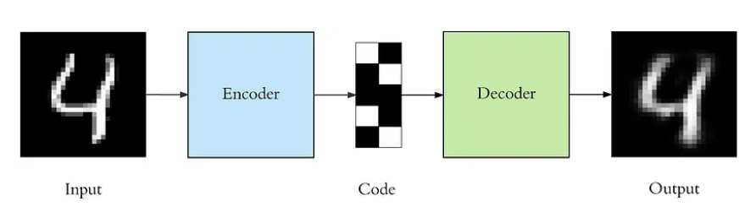
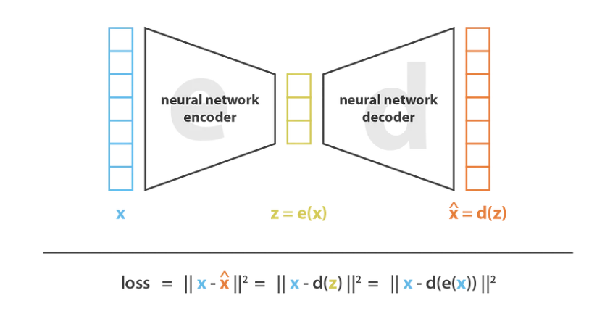
AutoEncoders

Slide 16
Question
Can we use this to generate new samples?

Slide 17
Why?
Autoencoder learns to create a code (compressed representation), not the probability distribution.
Code is dependent on neural network architecture, and code dimensions. Why?

Slide 18
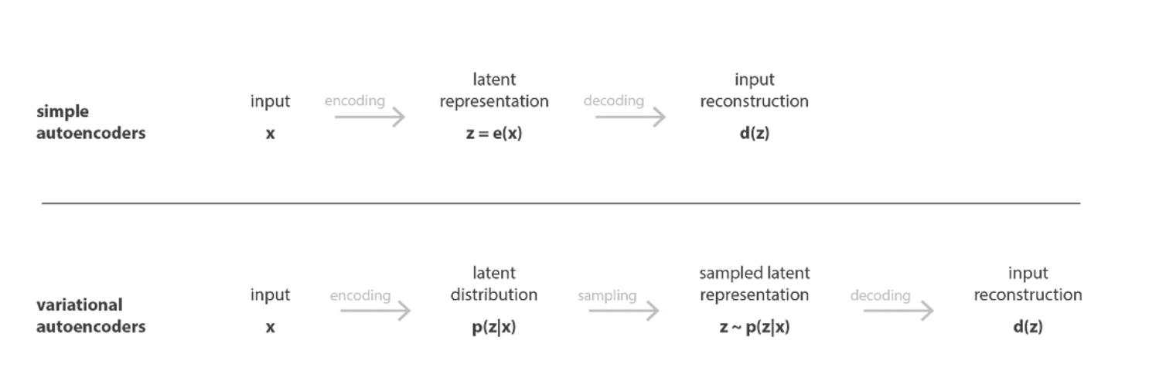
Variational Autoencoders

Slide 19
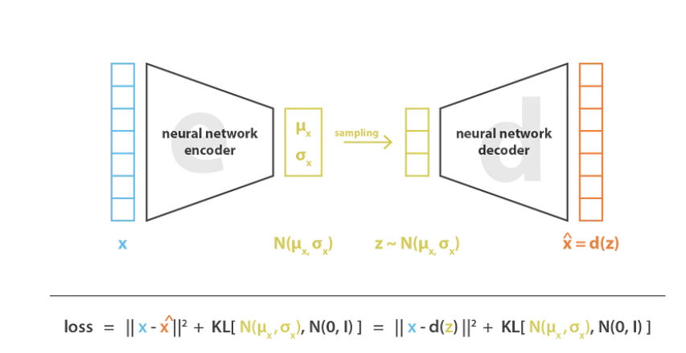
Variational Autoencoders

Slide 20
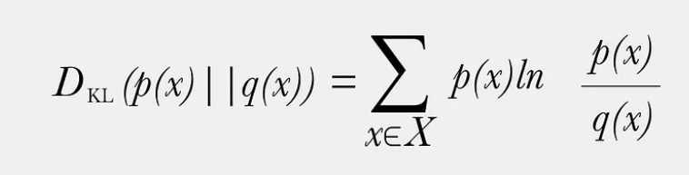

Slide 21
Question
Why Variational autoencoder needs to be regularized by constraining to Gaussian distribution?
To maintain regularity (to interpret and exploit the code):
Continuity: Two close points should point to same object.
Completeness: Chosen distribution should give meaningful information.

Slide 22
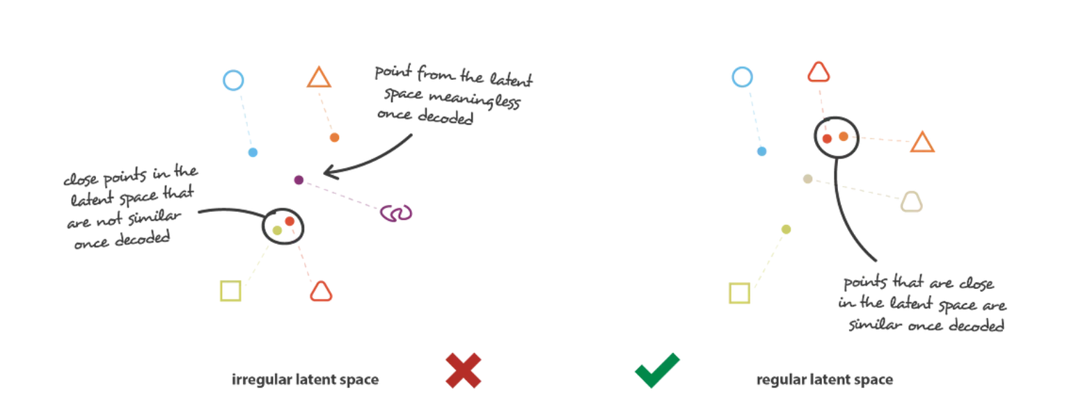
Regularity explanation

Slide 23
Thank You

